Slide 1
IoT Based Smart Home Environment using SCION
Burglar detection with motion sensors using MQTT, data analysis and machine learning over SCION
Guided by:
Prof. David Hausheer
Team
Abhijith Remesh (221424)
Manish RamaChandran (221423)

Slide 2
Table of Contents
Use case context
Overview : Application Schema
Overview : Key components
Hardware and Software Utilities
Implementation
Hardware interfacing
Data analysis and analytic approaches for Burglar detection
Historical data analysis
Artificial Intelligence approach
Statistical methods
Reports
Weekly Summary Report
Model Training Report
Automation - Services & Cron Jobs
Results
Node-RED GUI Dashboards
PIR + ESP Assembly
User Notification, InfluxDB Uploads, Grafana Viz.
Conclusion & Further Works

Slide 3
Use Case Context
Current Scenario:
Most of the Burglar detection systems employs the use of camera which causes
Insecurity to the users
Privacy of the users disturbed.
Proposed Idea :
To identify the presence of a intruder in our home from a remote location without the use of camera, rather using motion sensors.
The significant data components includes
Motion detections and respective timestamps
Online Switch value configurable by the user.
Mobile MAC value ( additional)
Merits : Privacy not disturbed !!!!

Slide 4
Overview : Application Schema
SCION IP
SCION IP
SIG
Raspberry Pi (SCION)
MQTT Broker
VM (SCION Client)
MQTT sub
MQTT
Grafana visualisation
Node-Red visualisation
InfluxDB
ESP (MQTT pub)
Motion sensor
Mobile MAC
Online switch

Slide 5
Overview : Key Components
Motion sensor coupled with ESP8266 ( Smart Battery management, WiFi manager) which acts as the MQTT pub and sends ‘Motion/Voltage’ on every detection.
Raspberry Pi with SCION AS and a MQTT broker installed which forwards the detection message to the client SCION AS (VM) through the SIG ( Scion Internet Gateway).
The client SCION AS as a MQTT sub subscribes on the same topic and receives the message, undergo several data analysis and machine learning approaches and provides Node-RED visualisation.
The Node-RED dashboard provides the online switch functionality and also the mobile MAC presence identification functionality.
The Node-RED uploads the data logged as csv onto the InfluxDB instance.
Node-Red Dashboard visualisation which gets the data packet through a HTTP get request.

Slide 6
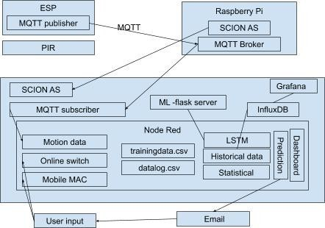
1
*d : detections
*s : schedule
*a : abnormal
0
2
*d
3a.
*s
3b.
3c.
*a
*a

Slide 7
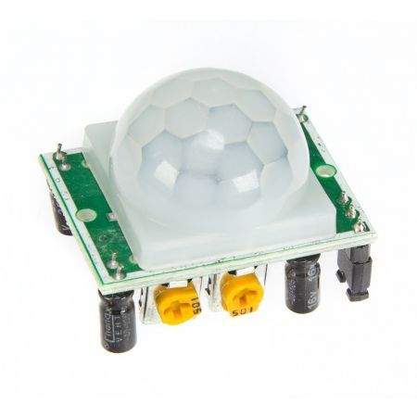
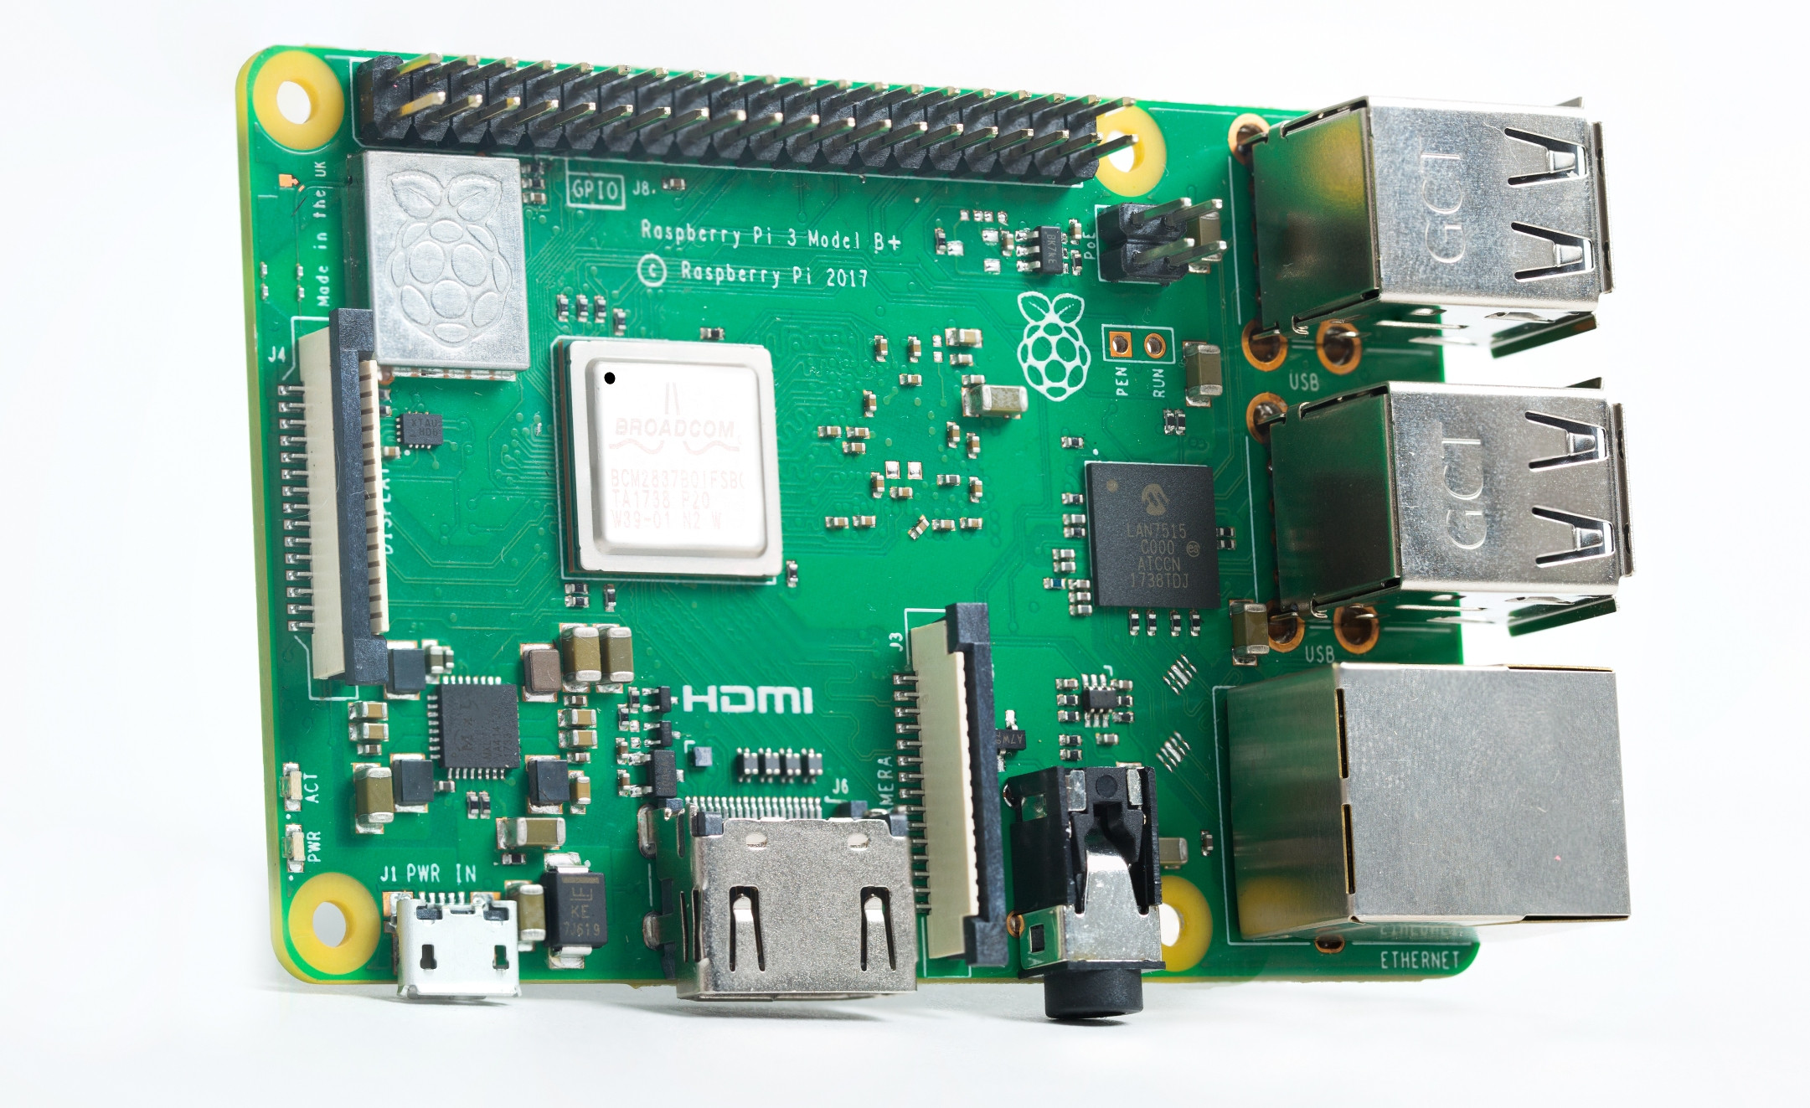

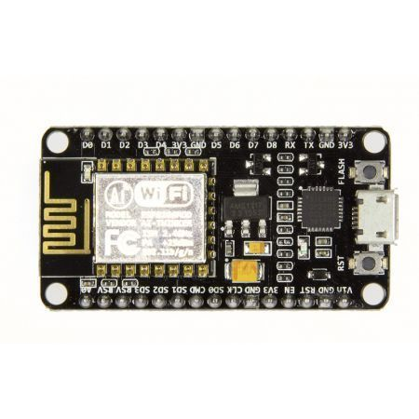



Hardware and Software Utilities
HC-SR501
Raspberry Pi 3 B+ Model
ESP 8266

Slide 8
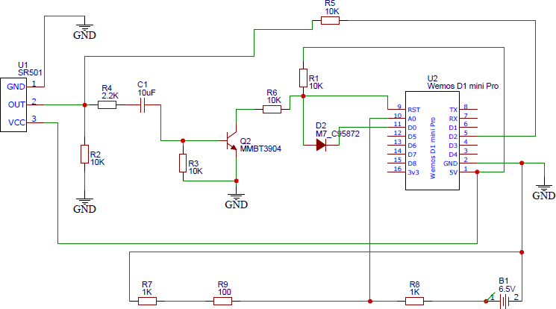
Hardware Interfacing

Slide 9
The current PCB circuit puts the ESP in deep sleep mode when not in use as a part of Battery Management.
The module wakes with an interrupt, publishes a MQTT message and goes back to sleep.
The easy set up of WiFi connection with a 2 way switch in ESP module using WifiManager library to avoid repetitive programming when we detect new WiFi connection.
The ESP can be connected to a battery setup or direct power.
The ESP can last for 8 days if there is 80 motion in average in an hour and if the battery capacity is around 2900mAh or more as per our calculations in Testing phase.
Because the MQTT message from ESP is “Motion/(batteryvoltage)”, the user in the client side get continuous notification about the battery health via Node-RED UI. Alerts is also set when the battery voltage steps down below 4.2V.

Slide 10
Data Analysis Approaches for Burglar Detection
Historical data analysis
Artificial Intelligence methods
Statistical methods

Slide 11
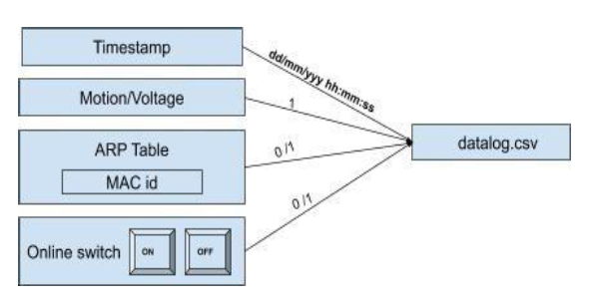
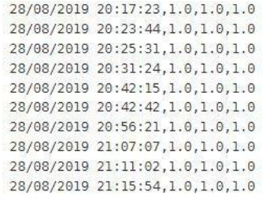
Historical data analysis
Logging Data to a local csv file (datalog.csv)
Timestamp, Motion value , online switch value, mobile mac value
It gets refreshed weekly.

Slide 12
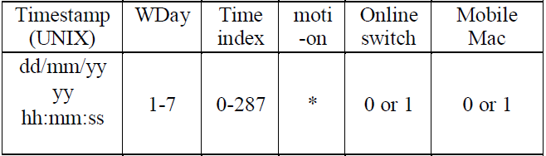
Logged data upload to the InfluXDB ‘historicaldb’
Periodically : Crontab job scheduled every Sunday(weekly) at 23:20:00
Retention policy of 6 months on ‘historicaldb’
Data format transformed over the fly into a five minute format.
Applying the historical search logic
Done in every 5 min interval
SELECT Query is passed to return the number of detections for every 5 min interval on the historical data.
In every 5 min, SELECT num_motion WHERE WDay = (1..7) & TimeIndex = (0….287)

Slide 13
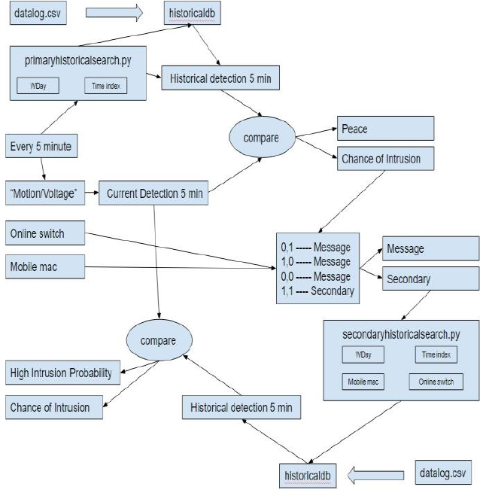
*w
1
2
1
3
1
2
4
6
5a
7
5b
8
11
10
9
12
10
*w

Slide 14
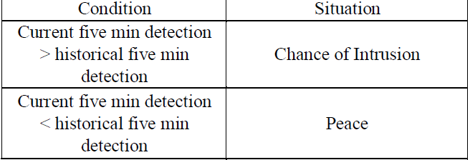
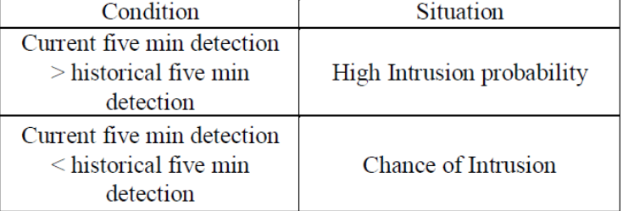
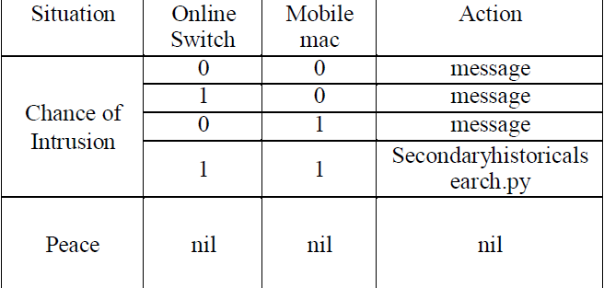
1st Compare:
2nd Compare:
After 1st Compare:

Slide 15
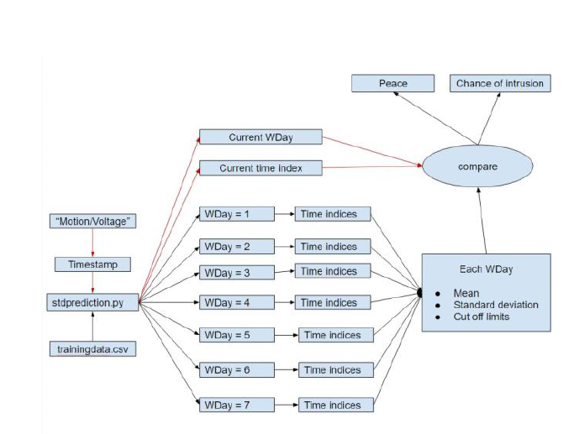
Statistical methods
Standard deviation method
Source file - logged csv data ( Timestamp, motion values, online switch, mobile mac)
Data converted in five minute format as WDay, Time Index.
Only considers data happened at user’s presence ( online switch: 1 and mobile mac: 1)
Collects/Groups the motion detection caused respective time indices of each WDay
Calculates Mean, Standard deviation parameters for Each WDay
On every real time detection, the time index is checked if it is deviating more than the cut offs.

Slide 16
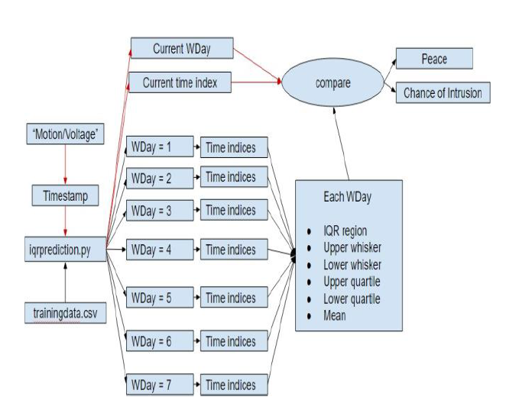
ARTIFICIAL INTELLIGENCE APPROACH
InterQuartile region
Source file - logged csv data ( Timestamp, motion values, online switch, mobile mac)
Data converted in five minute format as WDay, Time Index.
Only considers data happened at user’s presence ( online switch: 1 and mobile mac: 1)
Collects/Groups the motion detection caused respective time indices of each WDay
Calculates the IQR, whisker and quartile regions
On every real time detection, the time index is checked if it is inside/outside the regions.

Slide 17
Artificial Intelligence Approach
Application deals with motion and time series, best suited is the Time series forecasting model.
Long short-term memory (LSTM) is an artificial recurrent neural network (RNN) architecture used in the field of deep learning.
LSTM has feedback connections. It can not only process single data points (such as images), but also entire sequences of data (such as speech or video).
The lack of many training parameters, only time and motion values are only the parameters that are passed to the machine learning model. LSTM is preferred in such univariate time cases with plethora amount of data.
LSTM networks are well-suited to classifying, processing and making predictions based on time series data, since there can be lags of unknown duration between important events in a time series.
Whenever there is a motion detected, from the sensor, the data is recorded in the client side (Node-RED) as Timestamp : mm/dd/yy HH:mm:SS and motion value as “1”. This is the data format which is fed into our machine learning model as the input for training.

Slide 18
The machine learning model was built with 67 percent of motion data (timestamp aggregated as 5min duration and the corresponding motion values for the duration is added.) as training set and remaining set of test data was used to validate the same. The other parameters used to train model was
Batch Size : 1 Epochs : 1500 Neurons : 4 Loss : mean_squared_error Optimizer: adam
The LSTM model obtained was quite satisfactory with the RMSE score of 1.6 as per test data validation given below where the orange plot refers to the predictions.
The model was run on the machine with Flask application (framework) which is based on Python.The python script in Node-Red would take the motion value as its input argument and make an API call to our Flask application server where the model is loaded and running. The predicted value is fed back as the output of the script.

Slide 19
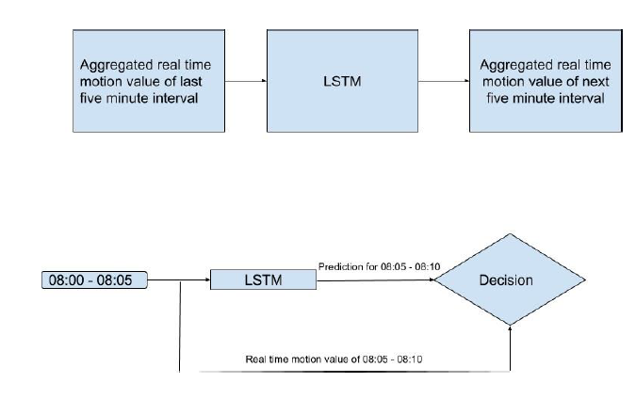

Slide 20
After comparison of real time and predicted values, a difference of these values are calculated.
If the difference is greater than 5 motions (which is a customization parameters and could vary with different applications and users), the final decision from the Machine learning side as Intrusion.
The output decision/response again depends on the value of ARP and online switch obtained. Again this decisive part depends on person to person who can customize the algorithm as per their choice.
If the output from LSTM is in a considerable range (threshold 5 motions) it is concluded as “Peace” ignoring switch and mac values.
However if the output from LSTM is considerably deviated from the normal range, then the decision is based on the obtained switch and mac values. The user is notified by an alert mail sent to their respective mail id. This is done using the mail node in Node-RED.

Slide 21
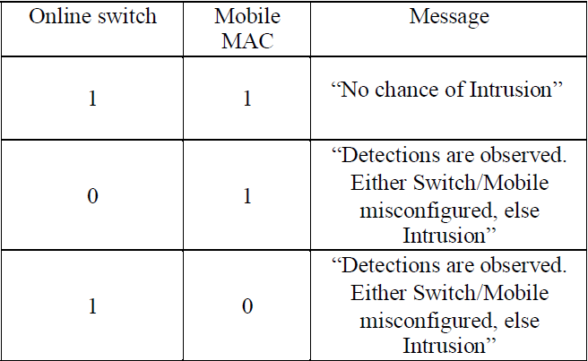

Slide 22
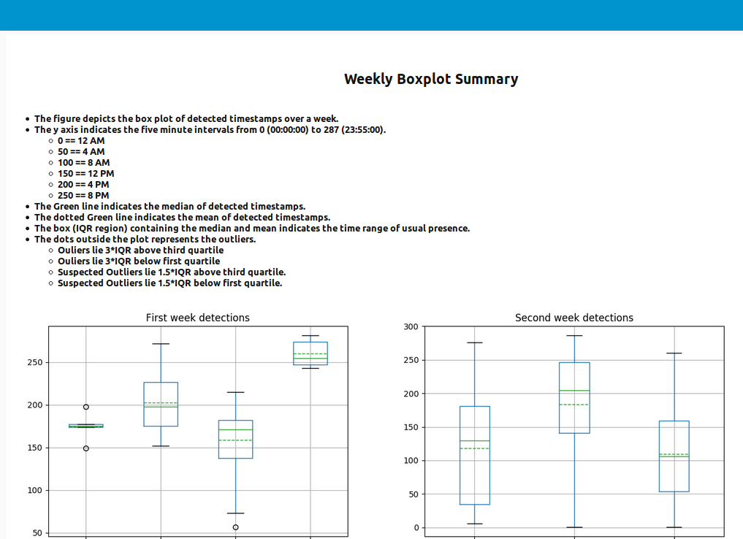
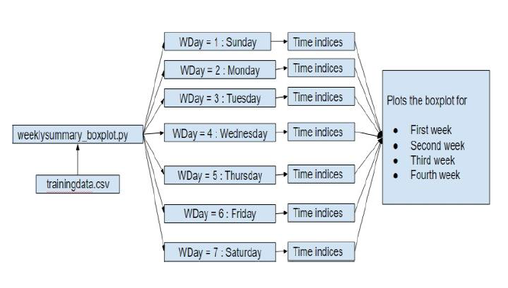
Reports
Weekly detection summary report
Source file : trainingdata.csv ( entire data logged)

Slide 23
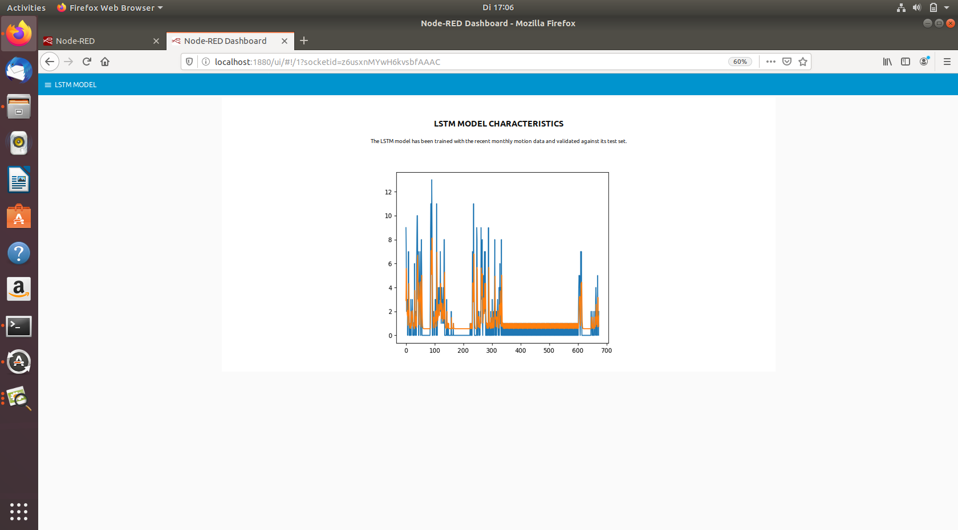
Model training report
The model training report which tells the accuracy of the model trained to the users.

Slide 24
Automation - Services and Cron Jobs
Service - modelstart.service auto starts the Flask ML Server
Service - NodeRed Service which will be running in the device.
CronJob - The weekly summary boxplot is scheduled to run every day at 9pm.
CronJob - The weekly influx load is scheduled to run every weekend to load the fresh motion data to influx database.
CronJob - The training lstm is scheduled to run every month to recreate a new efficient ml model based on the latest motion data.
CronJob - The refresh_training script is run after the above step to reset the monthly motion data.

Slide 25
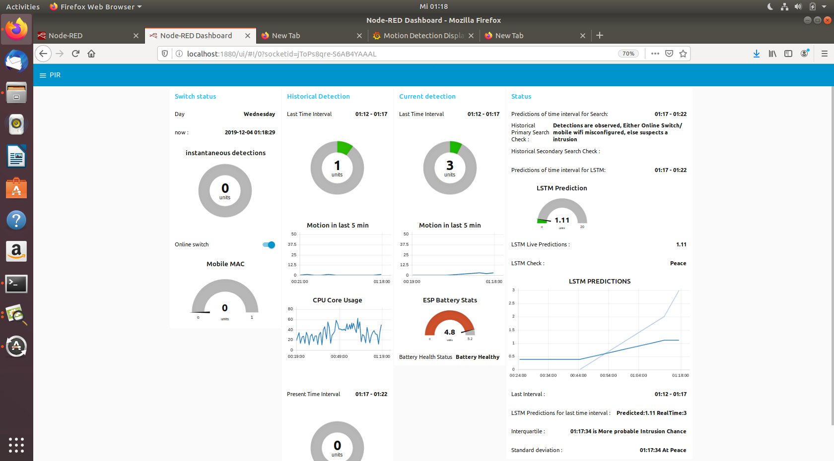
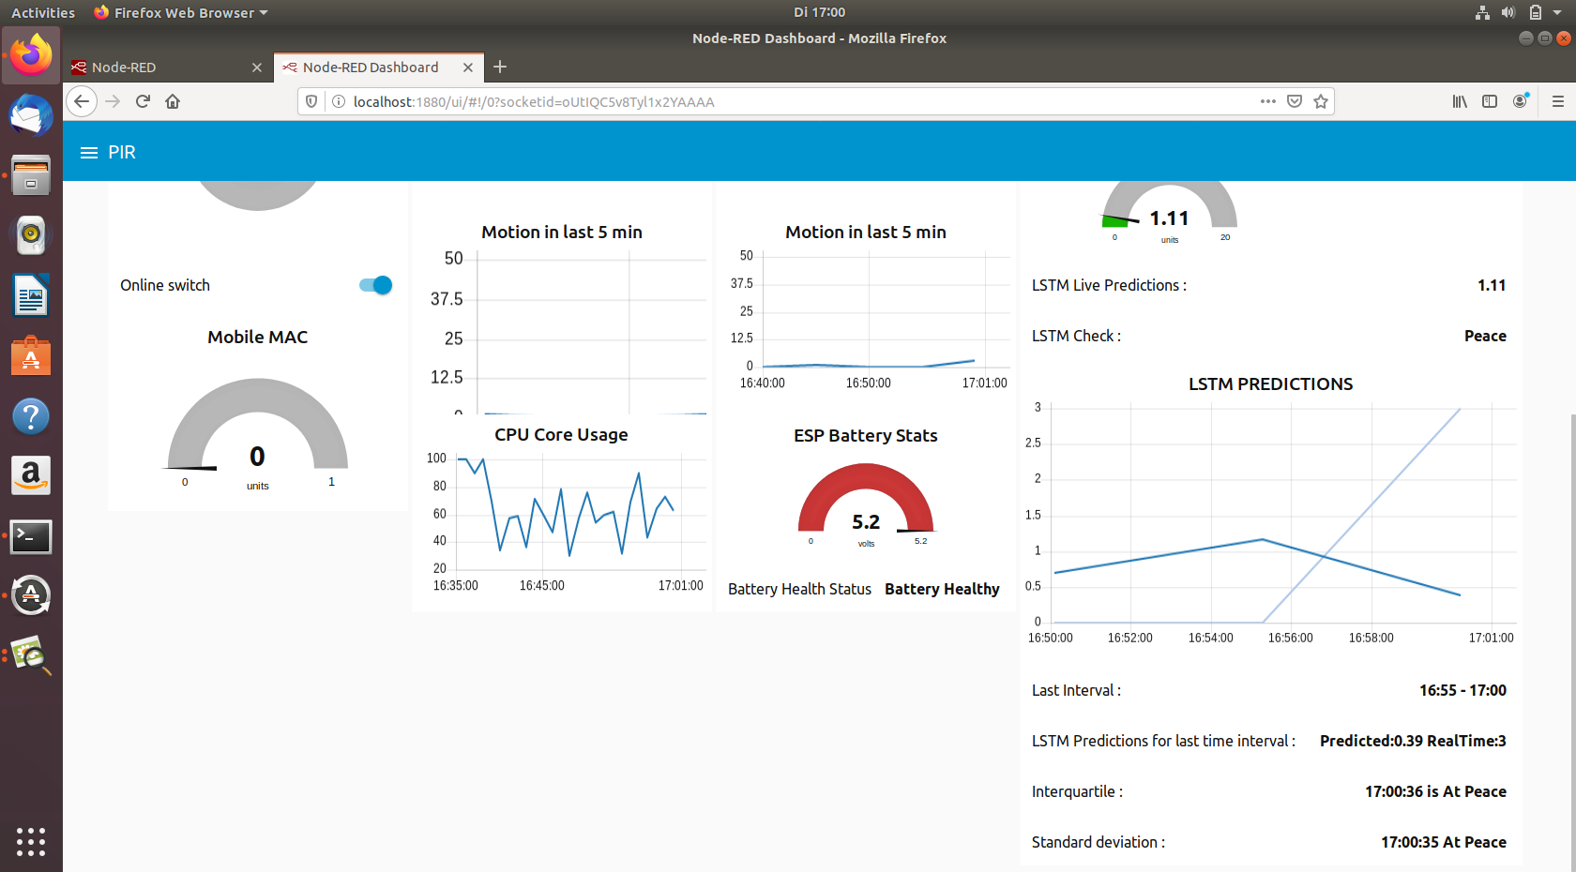
NODE-RED GUI dashboards

Slide 26
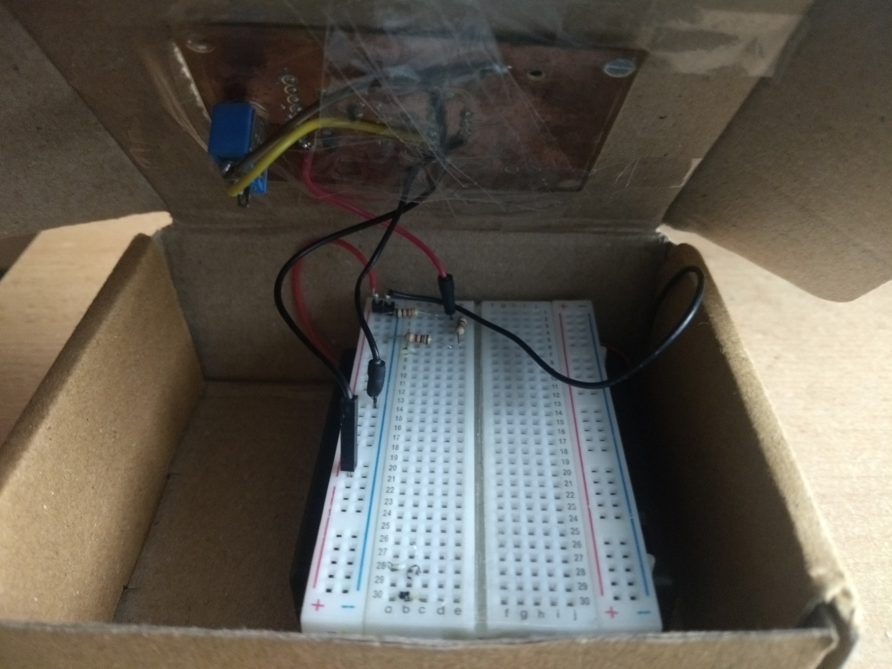
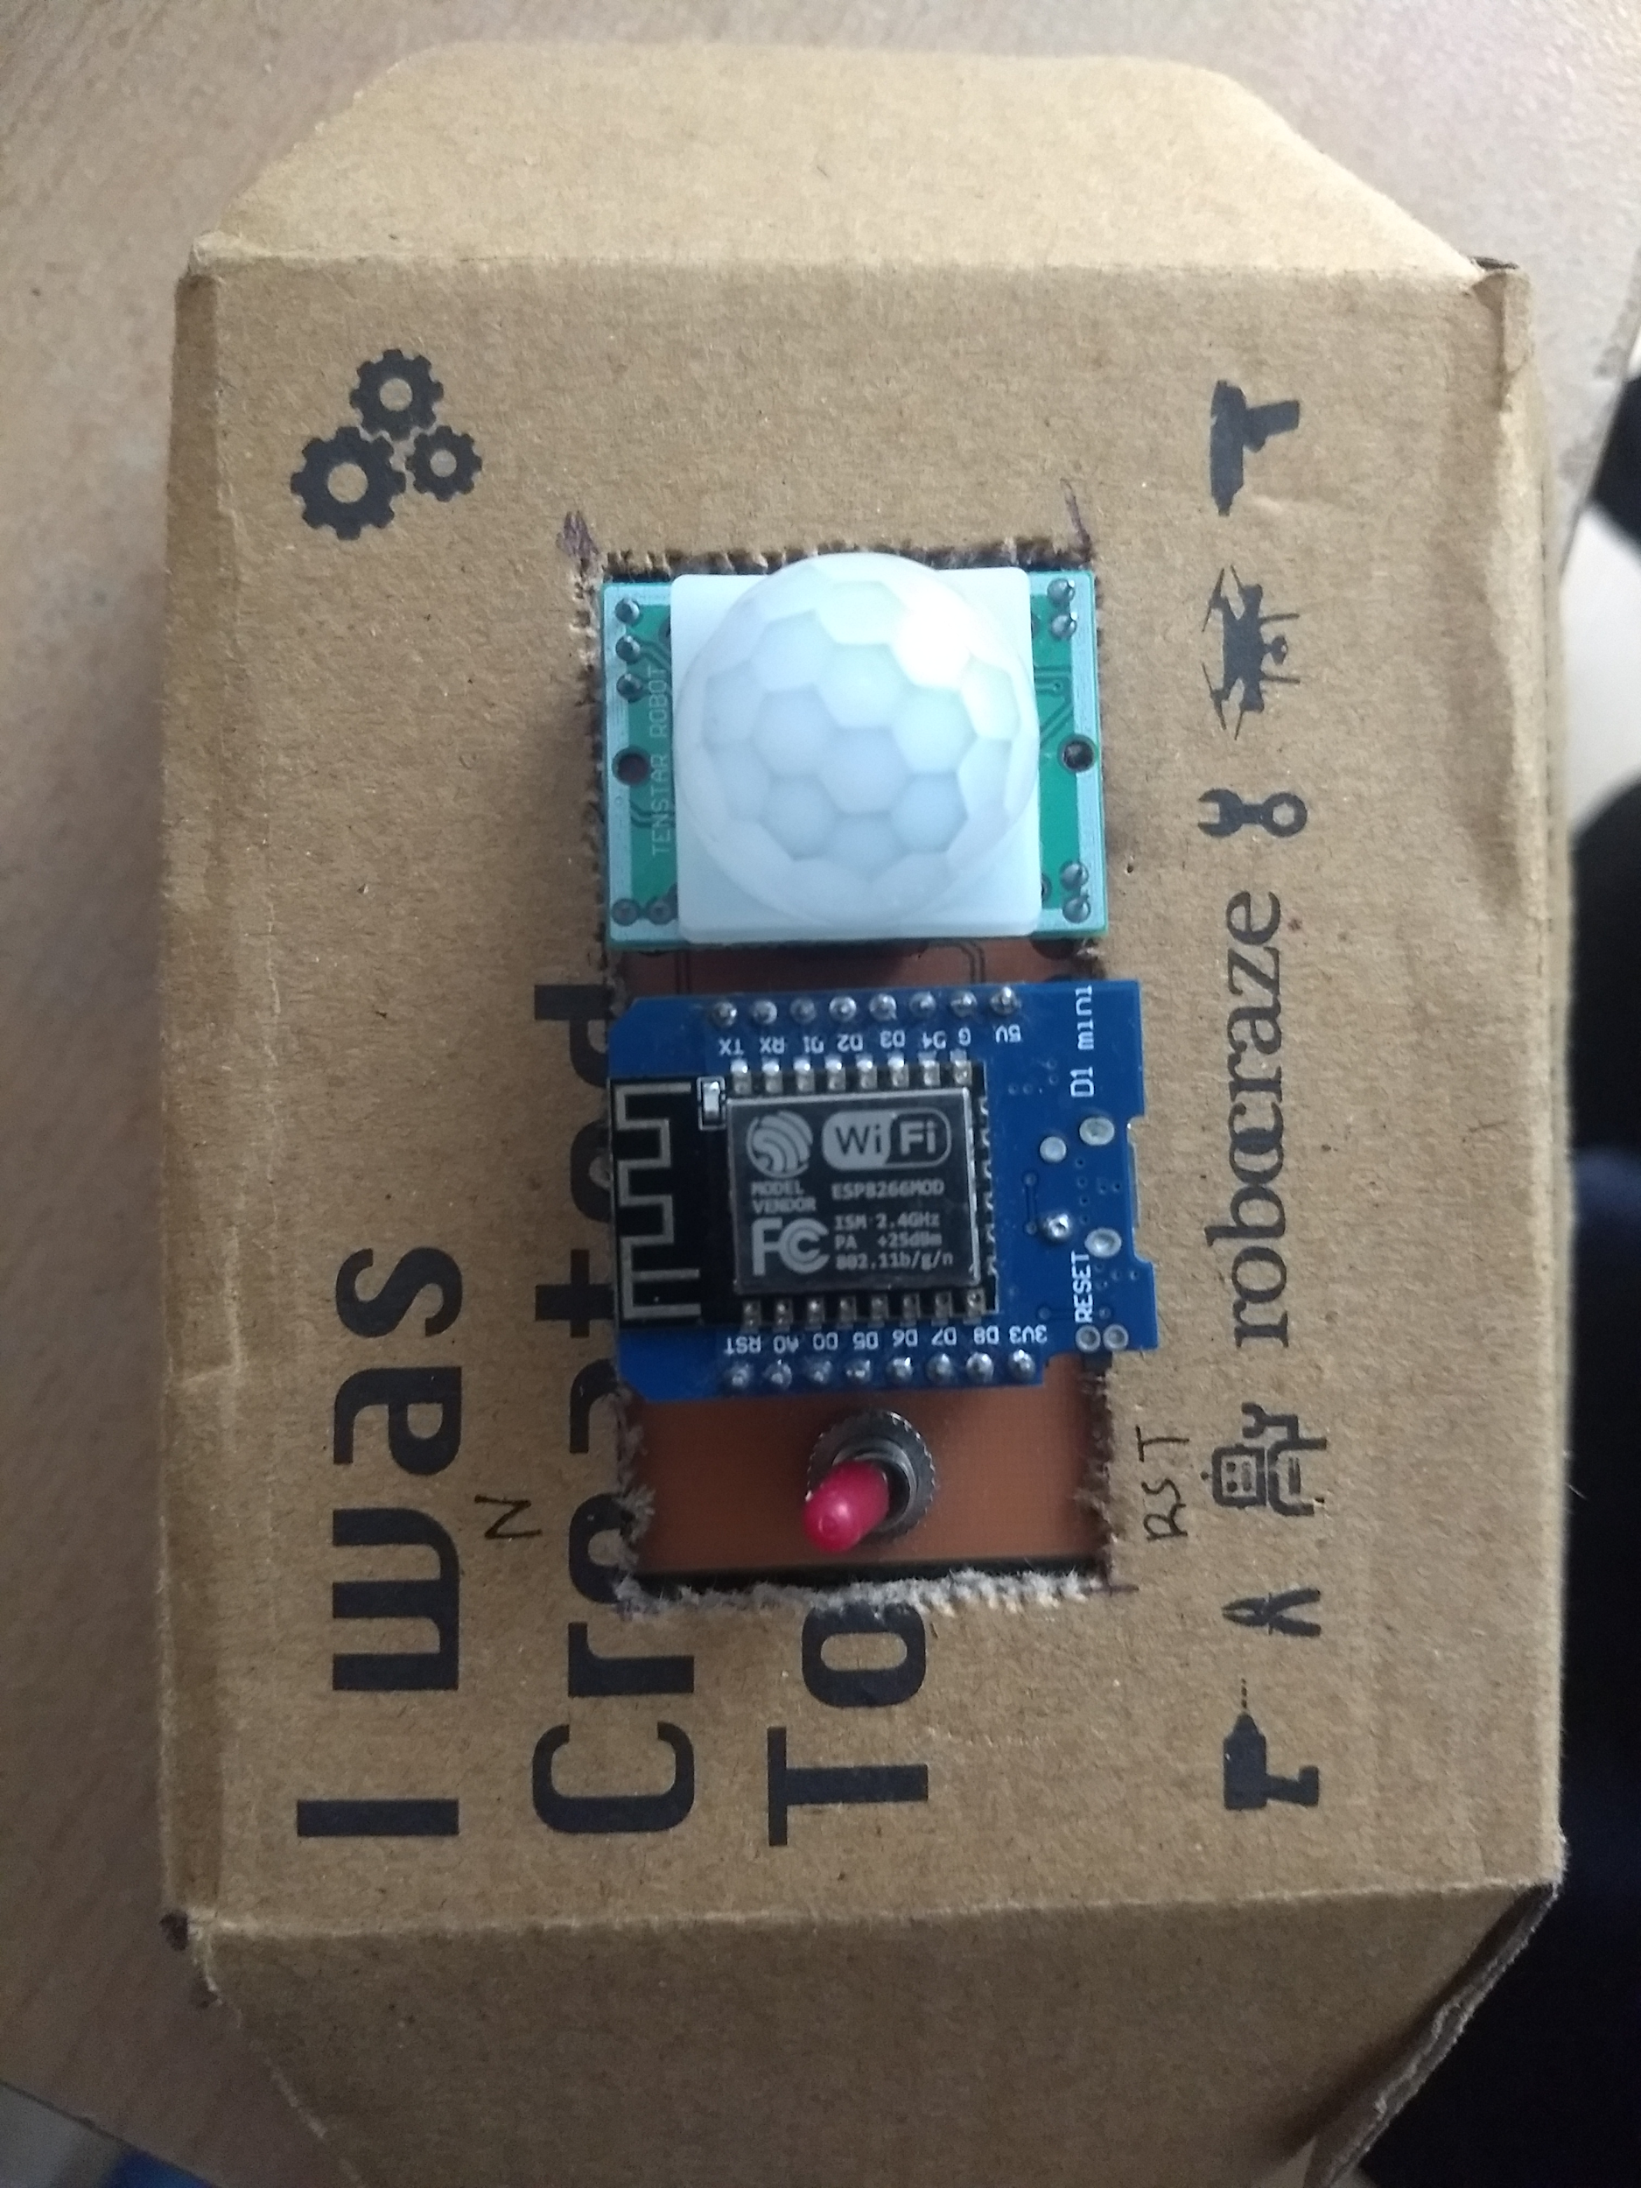
PIR+ESP Assembly

Slide 27
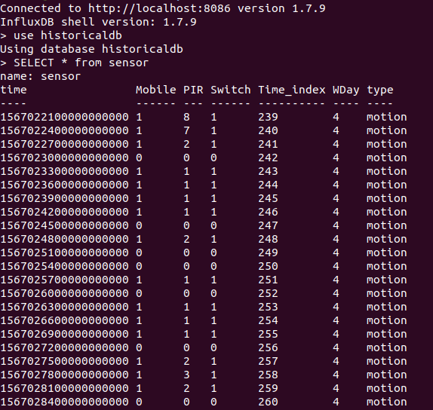
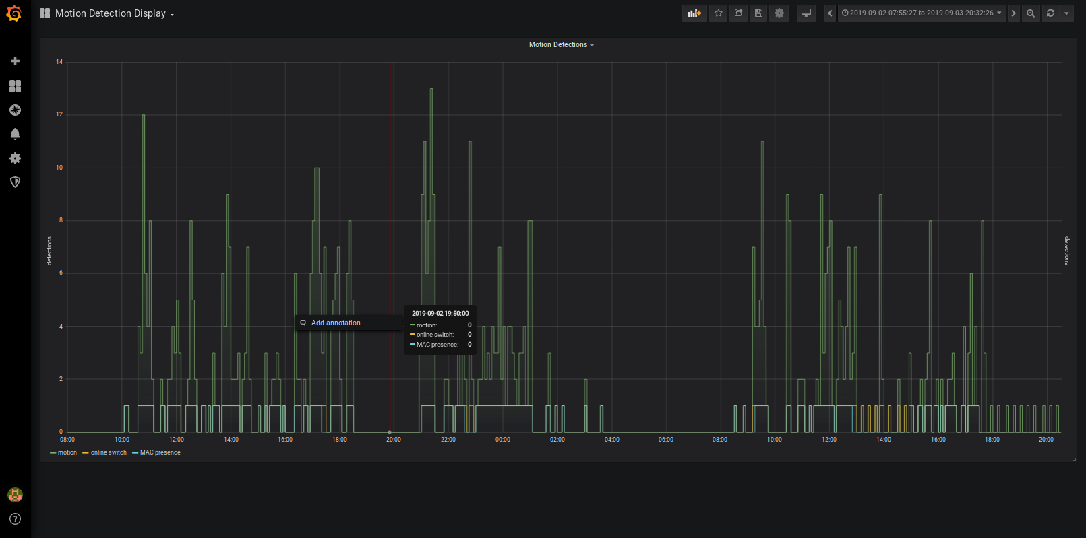
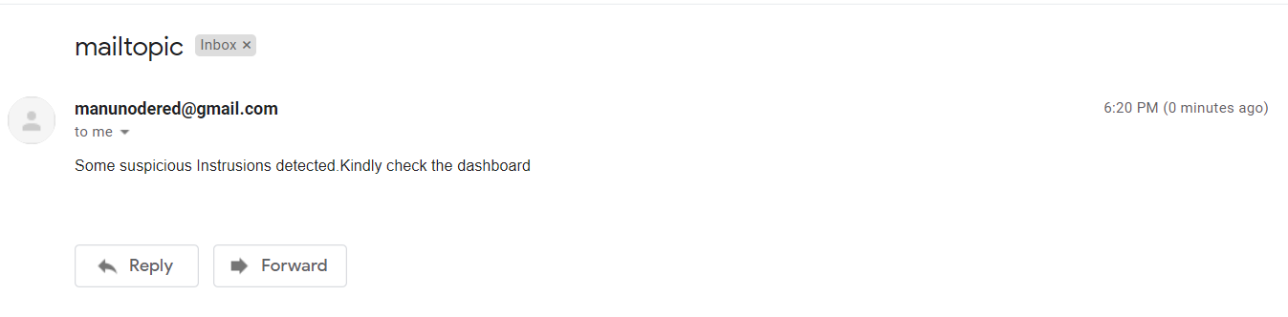
User notification, InfluxDB Uploads & Grafana Visualisation

Slide 28
Conclusion & Further works
Increase the number of motion sensors used.
Optimize the placement of the motion sensors installed.
Can infer the direction of motion and the speed of the motion happening.
Can infer the type of object - small, big, medium
Analysing the direction of motion - desirable direction or not.
Sequence of activation of the different motion sensors placed at different locations of the home.
If privacy is not a concern, employ cameras to confirm by taking a snapshot in case of abnormal situations which can be further used in image processing.

Slide 29
Thanks for your attention

